Slide 1
Hybrid Cloud Data Movement
Made By-
Asmita Porwal

Slide 2
Agenda
Project Statement
Project Overview
Project flow
Azure Resource used
Dataset Used
Implementation
Output

Slide 3
Project Statement Implement a project that involves moving and transforming data between an on-premises ,azure SQL Server database and Azure Synapse Analytics , Azure databrick , azure datafactory.

Slide 4
Project Overview
Our project revolves around building a comprehensive data engineering solution on Microsoft Azure, focusing on seamless data migration, transformation, and analytics. The key components of this end-to-end pipeline include:
● Data Ingestion
● Data Storage
● Data Transformation
● Data Governance
● Data Analytics
This project aims to empower organizations with a seamless, secure, and scalable data pipeline, providing the tools needed to make informed decisions through efficient data handling and compelling visual analytics. The combination of Azure services establishes a robust ecosystem, ensuring the success of the entire data journey.

Slide 5
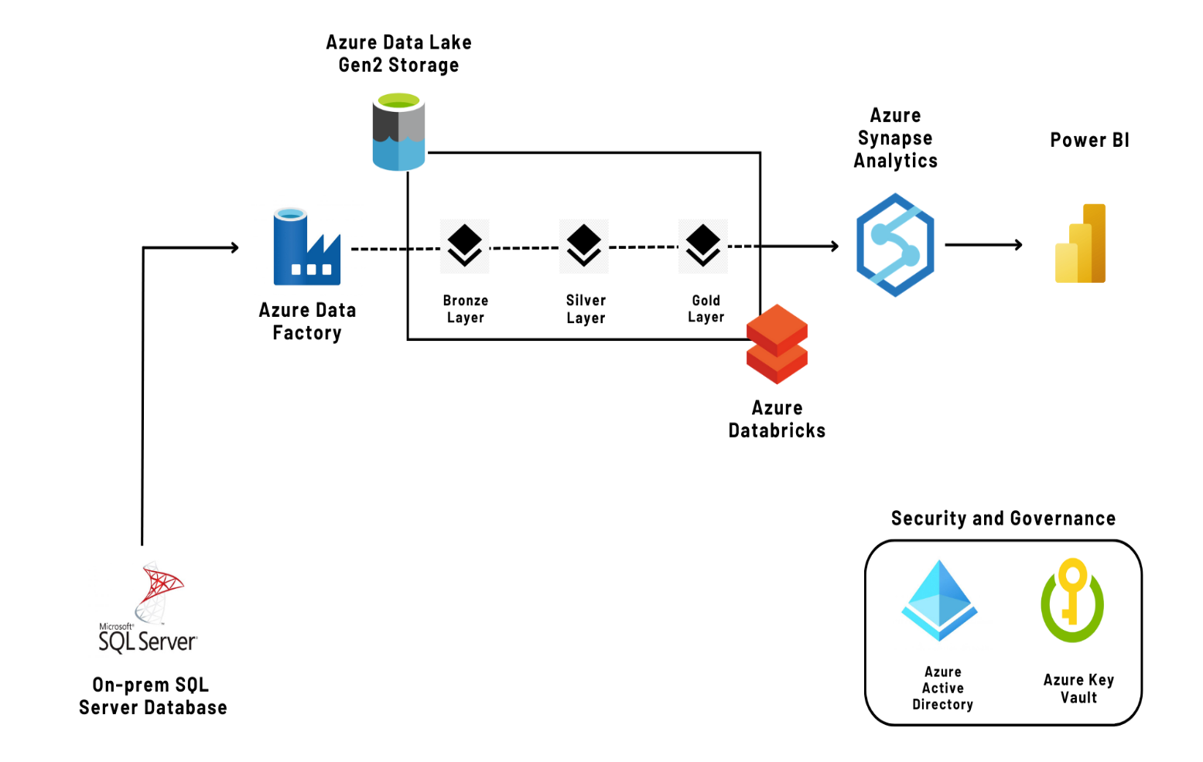
Project flow

Slide 6
Azure Resource used
Azure Data Lake Gen2 Storage
Azure Data Factory
Azure Databricks
Azure Synapse Analytics
Azure Key Vault
Microsoft Power BI

Slide 7
Dataset Used
The dataset is an open-source database provided by Microsoft namely 'AdventureWorks2017’.
It contains a lot of different tables with their corresponding relationships.
I have used light weight AdventureWorks2017

Slide 8
Implementation
Data Ingestion - Create a Self-Hosted Integration Runtime for on-premises SQL Server.
Data Storage - Copy data from SQL Server to Azure Data Lake Storage Gen2 using Azure Data Factory.
Data Transformation - Utilize Azure Databricks for data transformation.
Data Governance - Implement Azure Key Vaults and Active Directory for monitoring.
Data Analytics - Connect Power BI to Azure Synapse Analytics for visualizations.

Slide 9
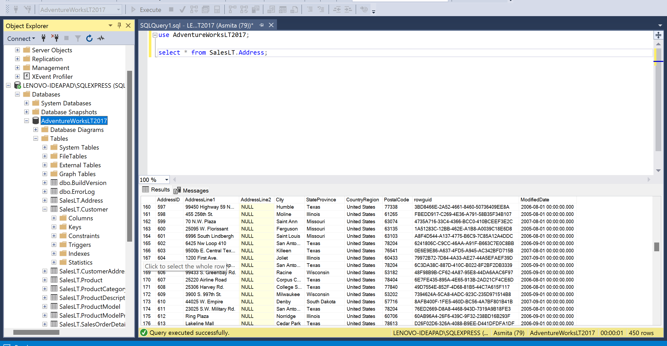
Output
Database on SQL server

Slide 10
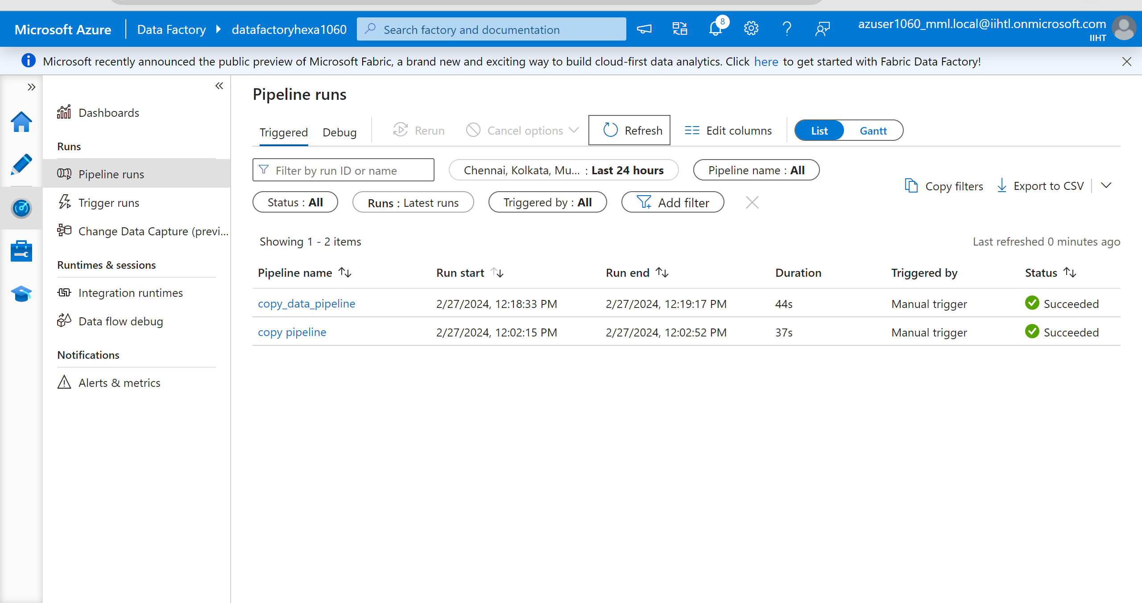
Output
Pipeline for copy data from local to cloud

Slide 11
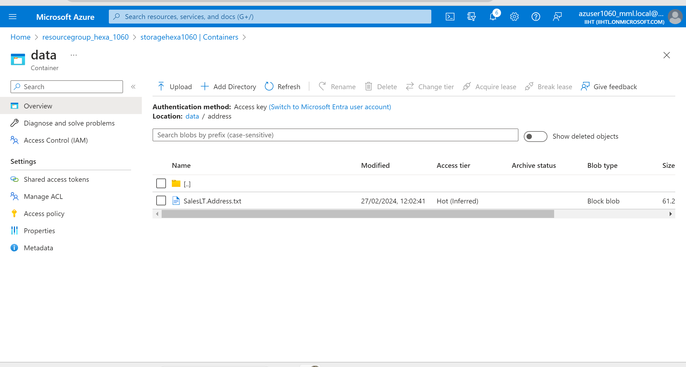
Output
Moved data to azure storage

Slide 12
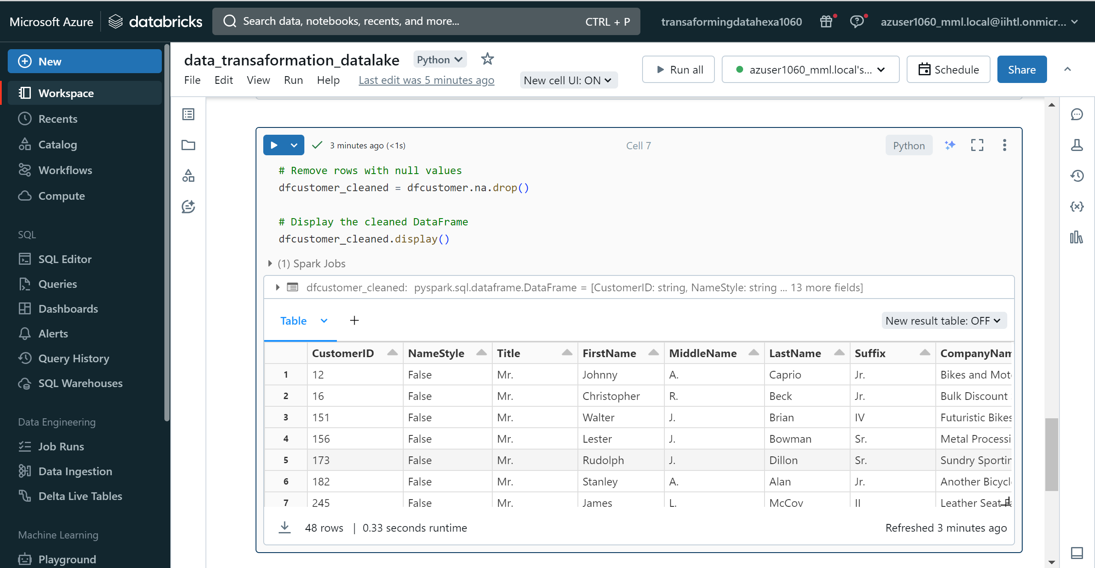
Output
Transforming data in data bricks

Slide 13
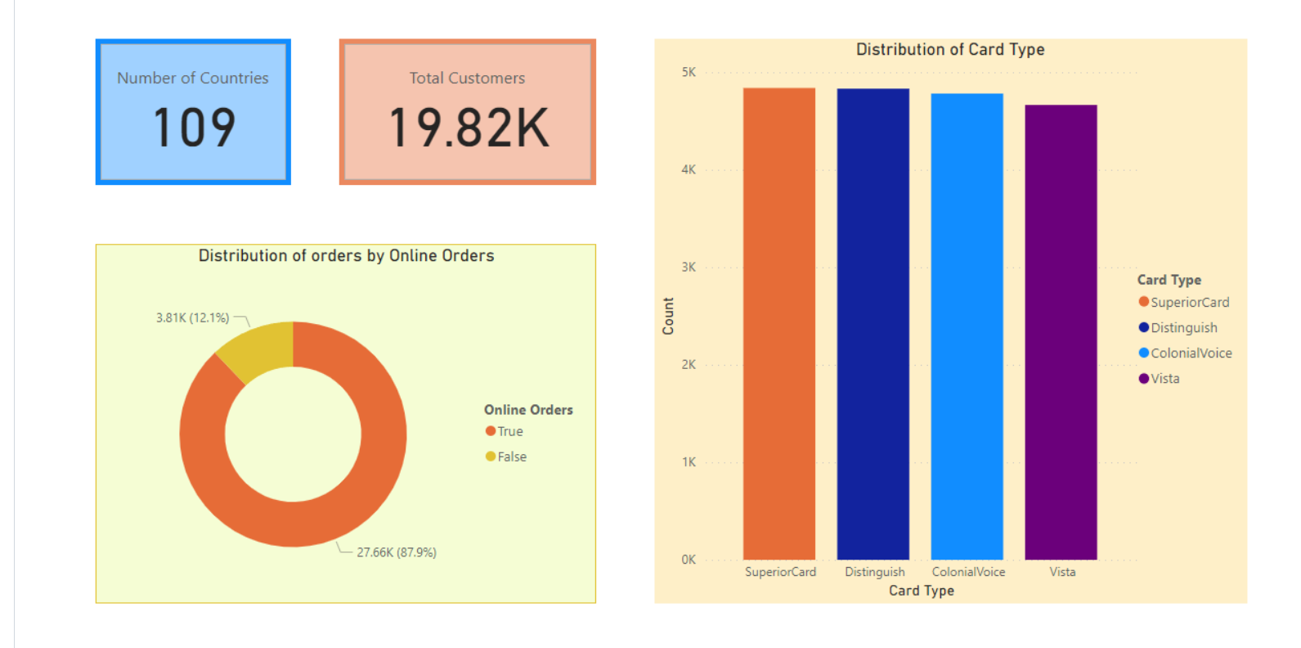
Output

Slide 14
Thank You

